Slide 3
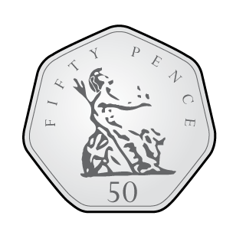
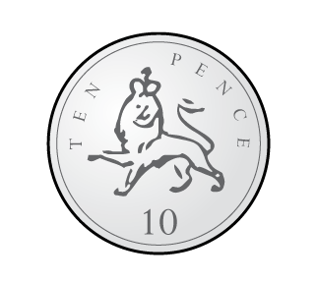
Ron has these coins. He spends 33p.
How much does he have left?
2) What is £1 subtract 50p?
3) What is £2 subtract 50p?
4) Complete the additions to make £1 each time
40p $+$ p $=$ £1 20p $+$ p $=$ £1
p $+$ 25p $=$£1 p + 55p = £1

Slide 4
Ron has these coins. He spends 33p.
How much does he have left?
2) What is £1 subtract 50p?
3) What is £2 subtract 50p?
4) Complete the additions to make £1 each time
40p $+$ p $=$ £1 20p $+$ p $=$ £1
p $+$ 25p $=$£1 p + 55p = £1
£2 and 50p
50p
£1 and 50p
60
80
75
45

Slide 6
Ron has £1 to spend.
How much change would he have if he bought…
a)
b)
Have a think
40p
60p change
£1 $−$40p $=$60p
$+$ 5p
$+$ 20p
75p
75p
80p
£1
25p change

Slide 7
Ron has £5 to spend.
How much change would he have if he bought…
a)
b)
Have a think
£2
£5 $−$ £2 $=$ £3
£3 change
$+$ 25p
$+$ £3
£1 and 75p
£1 and 75p
£2
£5
£3 and 25p change

Slide 8
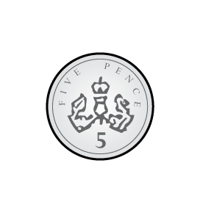
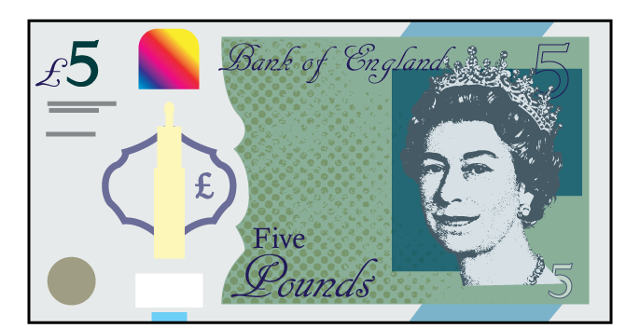
Jack buys a comic costing £4 and 55p. He pays £10
Which set shows the change he receives?
a)
b)
c)
£6 and 45p
£5 and 55p
£5 and 45p
$+$ 5p
$+$ 40p
$+$ £5
Have a think
£4 and 55p
£4 and 60p
£5
£10

Slide 9
Have a go at questions 1 – 3 on the worksheet

Slide 10
Whitney buys some flowers.
She pays with a £5 note and a £2 coin.
Here is the change she receives.
What is the cost of the flowers?
Have a think
cost of flowers
change
$+$ 9p
$+$ 40p
$+$ £5
£1 and 51p
£1 and 60p
£2
£7
£5 and 49p

Slide 11
Eva buys a bucket and spade.
She pays with a £5 note.
She gets 2 identical coins in change.
What could the price of the bucket and spade be?
What is the highest possible price?
What is the lowest?
£4 and 98p
£4 and 96p
£4 and 90p
Have a think

Slide 12
What could the price of the bucket and spade be?
What is the highest possible price?
What is the lowest?
£4 and 98p
£4 and 96p
£4 and 90p
£4 and 80p
£4 and 60p
£4
£3
£1

Slide 13
Have a go at the rest of the questions on the worksheet

